Slide 1

WEB TECHNOLOGY II
BCAC0021 : WEB TECHNOLOGY II
Module 1

Slide 2

Basic Requirements to build a website

Slide 3

(JavaScript)
Engine
(CSS)
Color
Design
Style
Metallic Body
(HTML)

Slide 4




How website works?
Client requests for the website
Server returns the response
Web Server

Slide 5

Role of HTML
HTML stands for Hyper Text Markup Language.
HTML is the standard markup language for creating Web pages.
HTML describes the structure of a Web page.
HTML consists of a series of elements.
HTML elements tell the browser how to display the content.

Slide 6

Role of CSS
CSS stands for Cascading Style Sheets.
CSS describes how HTML elements are to be displayed on screen, paper, or in other media.
CSS saves a lot of work. It can control the layout of multiple web pages all at once.
CSS makes our websites beautiful and modern looking.

Slide 7

Role of JAVASCRIPT
JavaScript, often known as JS, is a high-level dynamic interpreted programming language.
JavaScript is the programming language of the Web.
It allows client-side scripting to create completely dynamic web applications and websites.

Slide 8

Role of PHP
PHP is an acronym for "PHP: Hypertext Preprocessor“.
It was originally created by Rasmus Lerdorf in 1994.
PHP is a popular general-purpose scripting language.
PHP scripts are executed on the server.

Slide 9
Role of PHP
PHP is free to download and use.
PHP is an open-source
Interpreted
object-oriented scripting language
Rasmus Lerdorf in 1994 →market in 1995.
PHP 7.4.0 is the latest version of PHP

Slide 10
Why use PHP
Dynamic content, database as well as session tracking for the website.
Access cookies & Set Cookies.
Data Encrypt & Validation.
HTTP, POP3, SNMP, LDAP, IMAP
Simple Network Management Protocol
Light Weight Directory Access Protocol
Post Office Protocol 3
Internet Message Access Protocol
Control → user to access ????
Handle the forms, such as - collect the data from users

Slide 11
Basic Syntax of PHP
A PHP script can be placed anywhere in the document.
A PHP script starts with <?php and ends with ?>
<?php // PHP code goes here ?>
A PHP file normally contains HTML tags and some PHP scripting code.
A PHP script is executed on the server, and the plain HTML result is sent back to the browser.

Slide 12
Facts on PHP
PHP stands for Hypertext Preprocessor.
Interpreted Language -→ ??? [no need for compilation]
Faster than other scripting languages -→ JSP , ASP etc
Server-side scripting language → ?????
[ manage Dynamic Content]
Embedded into -→ HTML
Simple and easy to learn language → Open Source

Slide 13


Slide 14
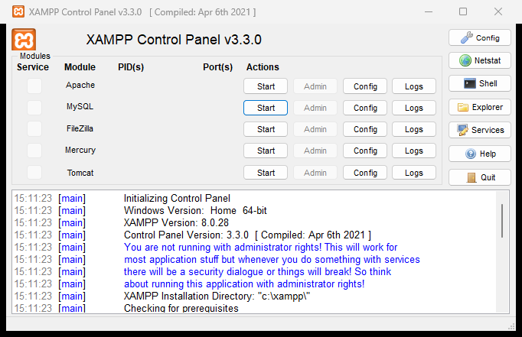
Installation
XAMPP download (Apache, PHP, MYSQL)
https://www.apachefriends.org/download.html
In xampp control panel, click on start for Apache and MySql
Visual Studio Code (Editor)
https://code.visualstudio.com/

Slide 15
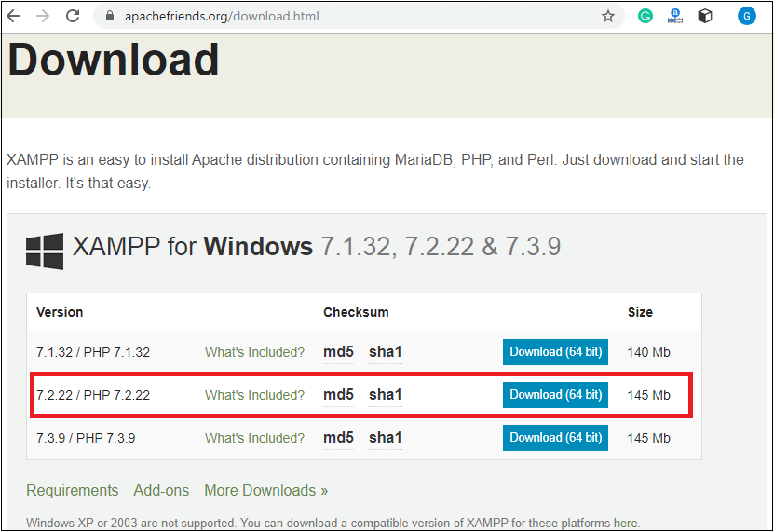
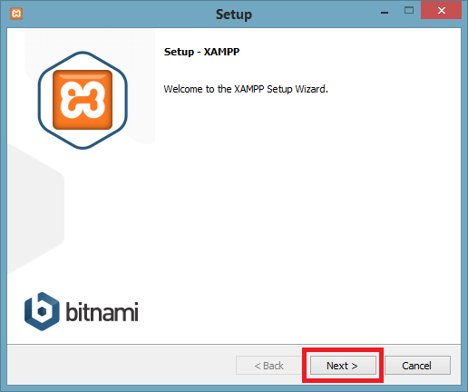
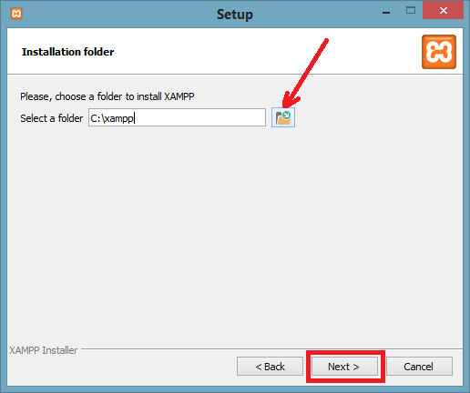
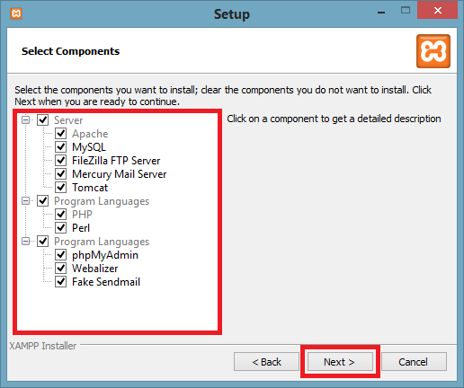

Slide 16
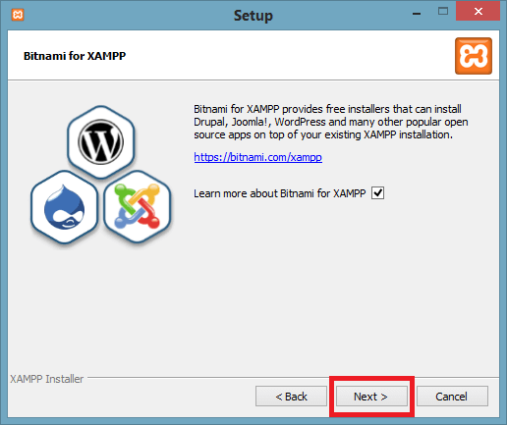
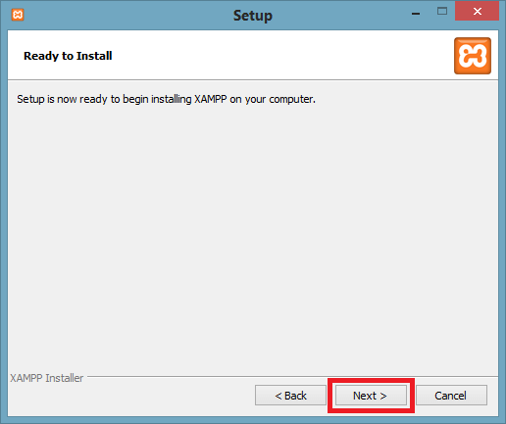
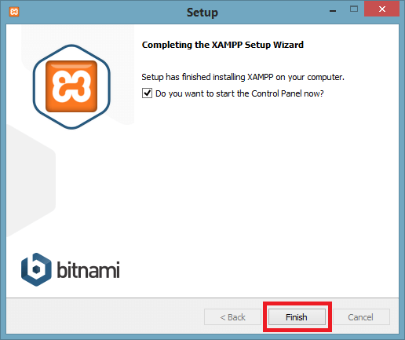
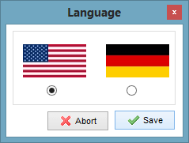

Slide 17
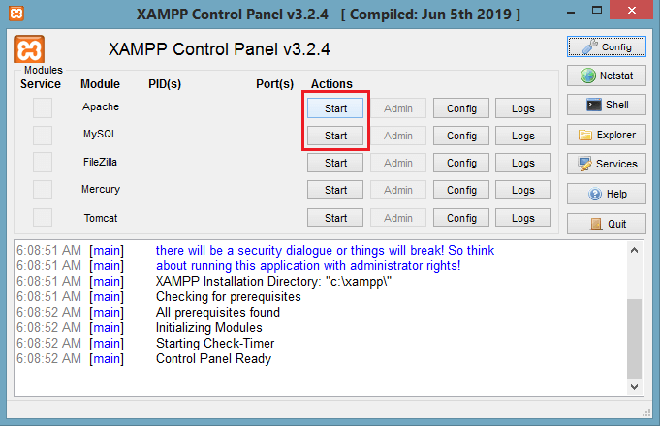
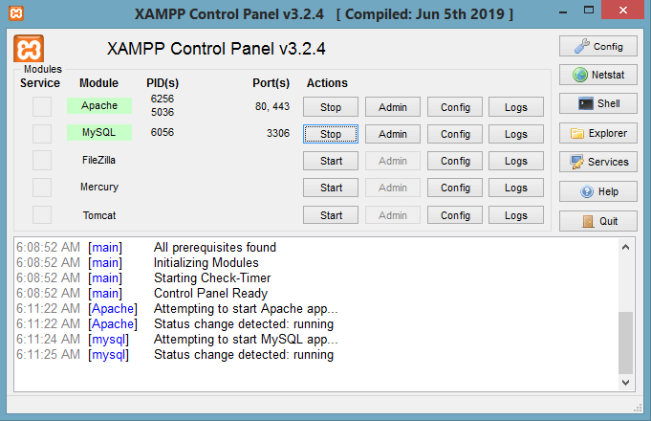

Slide 18
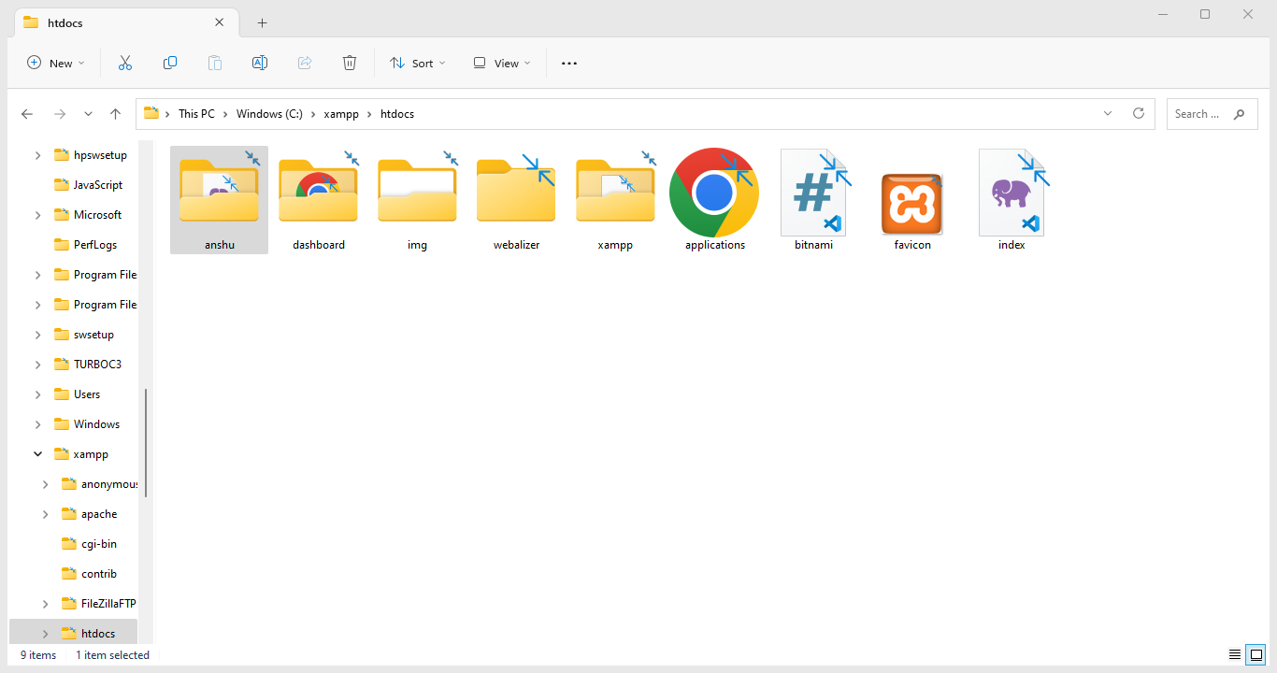
Installation
Open ‘c:/xampp/htdocs’ folder on your computer.
Make a new folder by your name(anshu)
Now open VS Code, and in that open the folder with your name (i.e. anshu).
Make your first php file in this folder and save it with ‘index.php’

Slide 19
Php Code
<?php
//your code here
?>
<!DOCTYPE>
<html>
<body>
<?php
echo "<h2>Welcome Students</h2>";
?>
</body>
</html>
HOW TO RUN ??

Slide 20
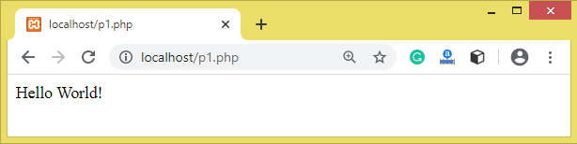
PHP programs can be written on any editor, such as - Notepad, Notepad++, Dreamweaver.
programs save with .php extension, i.e., filename.php inside the htdocs folder -→ xampp folder →C drive/ root Directory.→ computer/ PC.
Run the XAMPP server and start the Apache and MySQL.
Now, open the web browser and type localhost http://localhost/hello.php on your browser window.
The output for the above hello.php program will be shown as the screenshot.

Slide 21
<?php
echo "Hello by PHP echo";
?>
Printing String
<?php
echo "Hello by PHP echo
this is multi line
text printed by
PHP echo statement
";
?>
Printing Multi Line String
<?php
echo "Hello escape”,\"sequence\" ,characters";
?>
Printing Escaping Characters
<?php
$msg="Hello JavaTpoint PHP";
echo "Message is: $msg";
?>
Printing Variable Value
<?php
print "Hello by PHP print ";
print ("Hello by PHP print()");
?>
Printing String

Slide 22
Basic Syntax of PHP
<html> <body> <h1>My first PHP page</h1> <?php echo "Hello World!"; ?> </body> </html>
This PHP script uses a built-in PHP function "echo" to output the text "Hello World!" on a web page:
PHP statements end with a semicolon (;).

Slide 23
PHP Case Sensitivity
<!DOCTYPE html> <html> <body> <?php ECHO "Hello World!<br>"; echo "Hello World!<br>"; EcHo "Hello World!<br>"; ?> </body> </html>
In PHP, keywords (e.g. if, else, while, echo, etc.), classes, functions, and user-defined functions are not case-sensitive.
In the example, all three echo statements below are equal and legal:

Slide 24
PHP Case Sensitivity
<!DOCTYPE html> <html> <body> <?php $color = "red"; echo "My car is " . $color . "<br>"; echo "My house is " . $COLOR . "<br>"; echo "My boat is " . $coLOR . "<br>"; ?> </body> </html>
Only the first statement will display the value of the $color variable!
This is because $color, $COLOR, and $coLOR are treated as three different variables

Slide 25
PHP Comments
A comment in PHP code is a line that is not executed as a part of the program.
Its only purpose is to be read by someone who is looking at the code.
Comments can be used to:
Let others understand your code
Remind yourself of what you did

Slide 26
PHP Comments
PHP supports Two ways of commenting:
Single-line commenting (# or //)
Multiple line commenting (/*---------*/)
<!DOCTYPE html> <html> <body> <?php /* This is a multiple-lines comment block that spans multiple lines */ ?> </body> </html>
<!DOCTYPE html> <html> <body> <?php // This is a single-line comment # This is also a single-line comment ?> </body> </html>

Slide 27
PHP Variables
Variables are "containers" for storing information.
Creating (Declaring) PHP Variables
In PHP, a variable starts with the $ sign, followed by the name of the variable:
<?php
$str="hello string";
$x=200;
$y=44.6;
echo "string is: $str <br/>";
echo "integer is: $x <br/>";
echo "float is: $y <br/>";
?>
<?php $txt = "Hello world!"; $x = 5; $y = 10.5; ?>

Slide 28
PHP Variables
A variable can have a short name (like x and y) or a more descriptive name (age, carname, total_volume).
Rules for PHP variables:
A variable starts with the $ sign, followed by the name of the variable
A variable name must start with a letter or the underscore character
A variable name cannot start with a number
A variable name can only contain alpha-numeric characters and underscores (A-z, 0-9, and _ )
Variable names are case-sensitive ($age and $AGE are two different variables)
PHP is a loosely typed language.

Slide 29
PHP Variables Scope
In PHP, variables can be declared anywhere in the script.
The scope of a variable is the part of the script where the variable can be referenced/used.
PHP has three different variable scopes:
local
global
static

Slide 30
Local Scope
A variable declared within a function has a LOCAL SCOPE and can only be accessed within that function.
<?php function myTest() { $x = 5; // local scope echo "<p>Variable x inside function is: $x</p>"; } myTest(); // using x outside the function will generate an error echo "<p>Variable x outside function is: $x</p>"; ?>
Output:
Variable x inside function is: 5
Variable x outside function is:
One can have local variables with the same name in different functions, because local variables are only recognized by the function in which they are declared.

Slide 31
Global Scope
<?php $x = 5; // global scope function myTest() { // using x inside this function will generate an error echo "<p>Variable x inside function is: $x</p>"; } myTest(); echo "<p>Variable x outside function is: $x</p>"; ?>
A variable declared outside a function has a GLOBAL SCOPE and can only be accessed outside a function
Output:
Variable x inside function is:
Variable x outside function is: 5

Slide 32
Global Keyword
The global keyword is used to access a global variable from within a function.
To do this, use the global keyword before the variables (inside the function):
<?php $x = 5; $y = 10; function myTest() { global $x, $y; $y = $x + $y; } myTest(); echo $y; // output 15 ?>

Slide 33
Static Keyword
Normally, when a function is completed/executed, all of its variables are deleted.
However, sometimes we want a local variable NOT to be deleted.
We need it for a further job.
To do this, use the static keyword when you first declare the variable.

Slide 34
Static Keyword
<?php function myTest() { static $x = 0; echo $x; $x++; } myTest(); myTest(); myTest(); ?>
Output:
0
1
2

Slide 35
PHP Constants
Constants are like variables except that once they are defined they cannot be changed or undefined.
Constant is an identifier (name) for a simple value. The value cannot be changed during the script.
A valid constant name starts with a letter or underscore (no $ sign before the constant name).
Unlike variables, constants are automatically global across the entire script.

Slide 36
Create a PHP Constant
To create a constant, use the define() function.
Syntax
define(name, value, case-insensitive)
Parameters:
name: Specifies the name of the constant
value: Specifies the value of the constant
case-insensitive: Specifies whether the constant name should be case-insensitive. Default is false

Slide 37
Create a PHP Constant
<!DOCTYPE html>
<html>
<body>
<?php
//case-sensitive constant name
define("Web_Technology", "I am learning PHP");
echo Web_Technology;
?>
</body>
</html>
Output:
I am learning PHP
PHP Constant

Slide 38
Create a PHP Constant
<!DOCTYPE html>
<html>
<body>
<?php
// case-insensitive constant name
define("Web_Technology", "I am learning PHP", false);
echo WEB_TECHNOLOGY;
?>
</body>
</html>
Output:
WEB_TECHNOLOGY
PHP Constant

Slide 39
Constants are global
Constants are automatically global and can be used across the entire script.
<!DOCTYPE html>
<html>
<body>
<?php
define("BCA", "I am a student of BCA Third Year");
function myTest() {
echo BCA;
}
myTest();
?>
</body>
</html>
Output:
I am a student of BCA Third Year

Slide 40
PHP Operators
Operators are used to perform operations on variables and values.
PHP divides the operators into the following groups:
Arithmetic operators
Assignment operators
Comparison operators
Increment/Decrement operators
Logical operators
String operators
Array operators
Conditional assignment operators

Slide 41
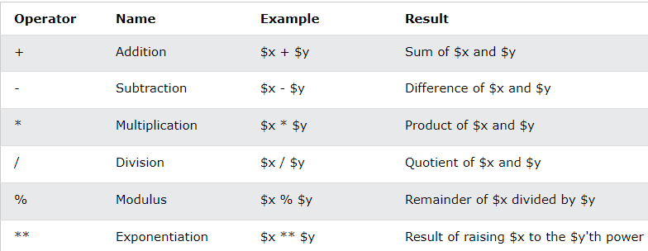
PHP Arithmetic Operators
The PHP arithmetic operators are used with numeric values to perform common arithmetical operations, such as addition, subtraction, multiplication etc.

Slide 42
<html>
<head> <title>Arithmetical Operators</title> <
/head>
<body>
<?php
$a = 42; $b = 20;
$c = $a + $b;
echo "Addtion Operation Result: $c <br/>";
$c = $a - $b;
echo "Substraction Operation Result: $c <br/>";
$c = $a * $b;
echo "Multiplication Operation Result: $c <br/>";
$c = $a / $b;
echo "Division Operation Result: $c <br/>";
$c = $a % $b;
echo "Modulus Operation Result: $c <br/>";
$c = $a++;
echo "Increment Operation Result: $c <br/>";
$c = $a--;
echo "Decrement Operation Result: $c <br/>"; ?>
</body>
</html>

Slide 43
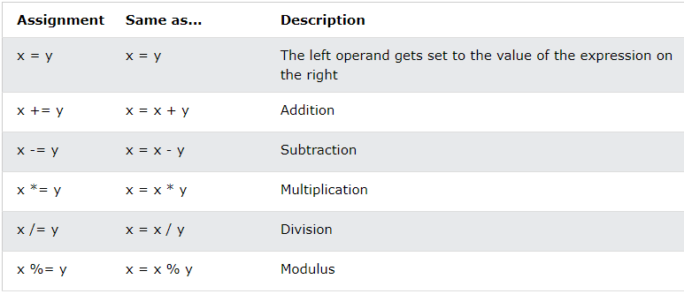
PHP Assignment Operators
The PHP assignment operators are used with numeric values to write a value to a variable.
The basic assignment operator in PHP is "=". It means that the left operand gets set to the value of the assignment expression on the right.

Slide 44
PHP Assignment Operators
The PHP assignment operators are used with numeric values to write a value to a variable.
The basic assignment operator in PHP is "=". It means that the left operand gets set to the value of the assignment expression on the right.

Slide 45
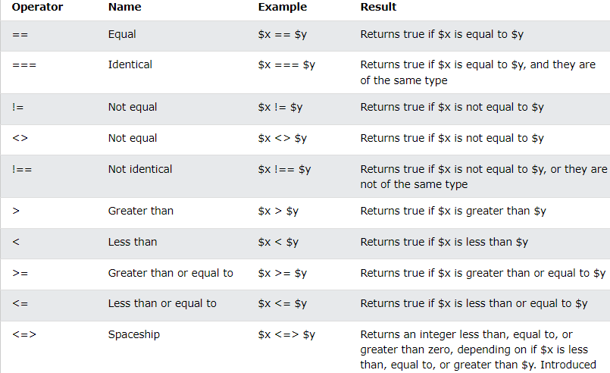
PHP Comparison Operators
The PHP comparison operators are used to compare two values (number or string):

Slide 46
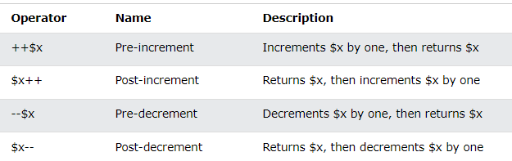
PHP Increment / Decrement Operators
The PHP increment operators are used to increment a variable's value.
The PHP decrement operators are used to decrement a variable's value.

Slide 47
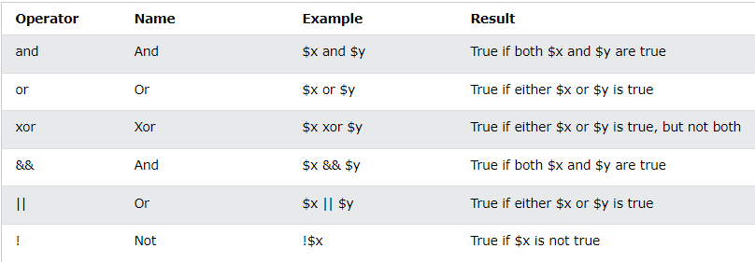
PHP Logical Operators
The PHP logical operators are used to combine conditional statements.

Slide 48
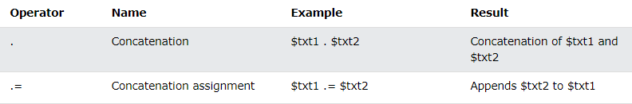
PHP String Operators
PHP has two operators that are specially designed for strings.

Slide 49
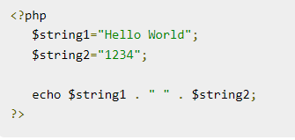

Slide 50
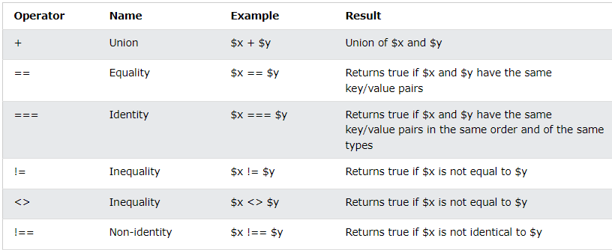
PHP Array Operators
The PHP array operators are used to compare arrays.

Slide 51
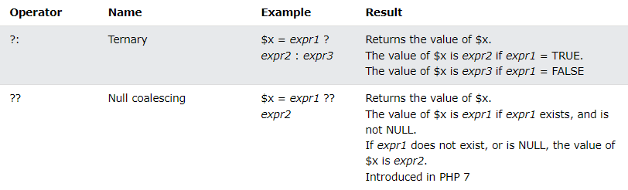
PHP Conditional Assignment Operators
The PHP conditional assignment operators are used to set a value depending on conditions:

Slide 52
PHP Strings
PHP string is a sequence of characters i.e., used to store and manipulate text.
There are 4 ways to specify a string literal in PHP.
single quoted
double quoted
heredoc syntax
newdoc syntax

Slide 53
PHP Strings
Single Quoted
A string in PHP can be created by enclosing the text in a single-quote.
It is the easiest way to specify string in PHP.
For specifying a literal single quote, escape it with a backslash (\) and to specify a literal backslash (\) use double backslash (\\).
All the other instances with backslash such as \r or \n, will be output same as they specified instead of having any special meaning.

Slide 54
PHP Strings
Double Quoted
In PHP, we can specify string through enclosing text within double quote also.
But escape sequences and variables will be interpreted using double quote PHP strings

Slide 55
PHP Strings
Heredoc
Heredoc syntax (<<<) is the third way to delimit strings.
In Heredoc syntax, an identifier is provided after this heredoc <<< operator, and immediately a new line is started to write any text.
To close the quotation, the string follows itself and then again that same identifier is provided.
That closing identifier must begin from the new line without any whitespace or tab.

Slide 56
PHP Strings
Newdoc
Newdoc is similar to the heredoc.
It is also identified with three less than symbols <<< followed by an identifier.
But here identifier is enclosed in single-quote, e.g. <<<'EXP'. Newdoc follows the same rule as heredocs.
The difference between newdoc and heredoc is that - Newdoc is a single-quoted string whereas heredoc is a double-quoted string.

Slide 57
PHP String Functions
strlen() - Return the Length of a String
The PHP strlen() function returns the length of a string
<!DOCTYPE html>
<html>
<body>
<?php
echo strlen("Hello world!");
?>
</body>
</html>
Output:
12

Slide 58
PHP String Functions
.
str_word_count() - Count Words in a String
The PHP str_word_count() function counts the number of words in a string
<!DOCTYPE html>
<html>
<body>
<?php
echo str_word_count("Hello world!");
?>
</body>
</html>
Output:
2

Slide 59
PHP String Functions
.
.
strrev() - Reverse a String
The PHP strrev() function reverses a string
<!DOCTYPE html>
<html>
<body>
<?php
echo strrev("Hello world!");
?>
</body>
</html>
Output:
!dlrow olleH

Slide 60
PHP String Functions
.
.
strpos() - Search For a Text Within a String
The PHP strpos() function searches for a specific text within a string. If a match is found, the function returns the character position of the first match. If no match is found, it will return FALSE.
<!DOCTYPE html>
<html>
<body>
<?php
echo strpos("Hello world!", "world");
?>
</body>
</html>
Output:
6

Slide 61
PHP String Functions
.
.
str_replace() - Replace Text Within a String
The PHP str_replace() function replaces some characters with some other characters in a string.
<!DOCTYPE html>
<html>
<body>
<?php
echo str_replace("world", "Dolly", "Hello world!");
?>
</body>
</html>
Output:
Hello Dolly!

Slide 62
PHP String Functions
.
.
Name of the Function | Function
trim() | Remove whitespace or other characters from the beginning and end of the string.
ucfirst() | Make the first character of the string to uppercase
ucwords() | Make the first character of each word in a string to uppercase
substr_count() | Count the number of times occurrence of a substring
strtolower() | Convert a string to its lower case
strtoupper() | Convert a string to its upper case

Slide 63
PHP Function
<?php function BCA()
{ echo "Hello world!"; } BCA(); // call the function ?>
<?php function BCA($Sname)
{ echo "$Sname <br>"; } BCA(“Ram"); BCA(“Shyam"); ?>
Arguments

Slide 64
<?php
function BCA(Sname, $rollno)
{
echo "$name is $rollno<br>";
}
BCA(“Ram","75");
BCA("Sita","78");
BCA("Kaijal","83");
?>
<?php
function add_Numbers(int $a, int $b)
{
return $a + $b;
}
echo add_Numbers(5,);
?>

Slide 65
<?php declare(strict_types=1); ?>
<?php
function set_Height(int $minheight = 50)
{
echo "The height is : $minheight <br>";
}
Set_Height(350);
Set_Height();
Set_Height(135);
Set_Height(80);
?>

Slide 66
<?php declare(strict_types=1); ?>
<!DOCTYPE html>
<html>
<body>
<?php
function sum(int $x, int $y)
{
$z = $x + $y;
return $z;
}
echo "5 + 10 = " . sum(5,10) . "<br>";
echo "7 + 13 = " . sum(7,13) . "<br>";
echo "2 + 4 = " . sum(2,4);
?>
</body>
</html>

Slide 67
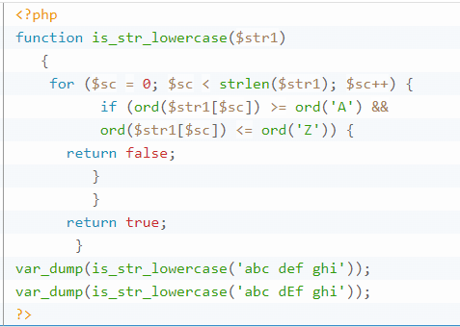

Slide 68
<?php
function is_string_lower($str){
for ($i =0; $i < strlen($str); $i++){
if(ord($str[$i]) >= ord('A') && ord($str[$i] <= ord('Z'))){
retun -1;
}
else
return 1;
}
}
$result= is_string_lower('abcdef');
if($result == 1)
echo "string is in lower case";
else
echo "String is not in lower case";
?>

Slide 69
Important Programs
Write a function to reverse a string.
Write a PHP function that checks whether a string is all lowercase.
Write a function to calculate the factorial of a number (a non-negative integer). The function accepts the number as an argument.

Slide 70
<?php $str = addcslashes("Hello World!","W"); echo($str); ?>
backslashes in front of the specified characters
<?php
$str = addslashes('What does "your" mean?');
echo($str);
?>
Add a backslash in front of each double quote (")
<?php
$str = bin2hex("Hello World!");
echo($str);
?>
Convert → hexadecimal values
<?php $str = "Hello World!"; echo $str . "<br>"; echo chop($str,"World!"); ?>
Removes → Whitespaces or other predefined characters
from the right end of a string

Slide 71
<?php
echo chr(52) . "<br>";
echo chr(055) . "<br>";
echo chr(0x56) . "<br>";
?>
Character from the specified ASCII value
<?php $str = "Hello world!"; echo chunk_split($str,1,"."); ?>
Splits a string into a series of smaller parts
<?php
$str = "Hello world!";
echo chunk_split($str,6,"...");
?>
Split the string after each sixth character and add a "..." after each split

Slide 72
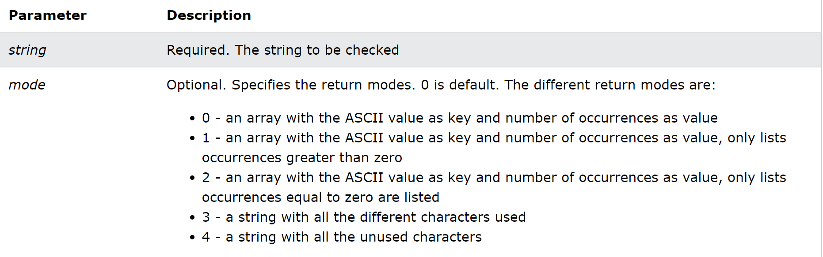
<?php $str = "Hello World!"; echo count_chars($str,3); ?>

Slide 73
<?php $arr = array('Hello',‘Dear!','Beautiful','Day!'); echo join(" ",$arr); ?>
Join array elements with a string
<?php $number = 1234.56; setlocale(LC_MONETARY,"en_US"); echo money_format("The price is %i", $number); ?>
setlocale(LC_MONETARY,"en_US");
Setlocale(LC_MONETARY,"de_DE");
<?php $number = -1234.5672; echo money_format("%=*(#10.2n",$number); ?>
(******1234.57)
<?php
echo similar_text("Hello World","Hello Peter");
?>
between two strings and return
the matching characters

Slide 74


Problems
ltrim() - Removes whitespace from the left side of a string
rtrim() - Removes whitespace from the right side of a string
<?php $str = "Hello World!"; echo $str . "<br>"; echo trim($str,"Hed!"); ?>
trim()
Hello World! Beautiful Day! Hello+World!+Beautiful+Day! Hello-World!-Beautiful-Day! HelloXWorld!XBeautifulXDay!

